Slide 1



Supply Chain Analysis
Prepared by Group : ONLI_DAT2_G9e
Last updated : 19/10/2024

Slide 2
Agenda
1
2
3
4
5
Introduction
Business
Task
Summary of the Analysis
Insights &
Recommendations
Reference & Contact info

Slide 3

Introduction
Our Company (Just In Time) sells products across multiple regions, including Europe, Latin America (LATAM), and Pacific Asia. They deal in various product categories such as Sporting Goods, Women's Apparel, and Fitness. The company operates two main warehouses in Puerto Rico and the USA, which handle the storage and shipment of products to customers worldwide.

Slide 4
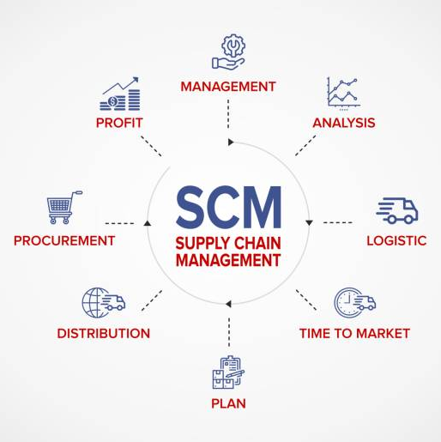
Business Task
Analyzing shipment performance across different regions and shipment modes.
What is the average fulfillment time for orders, and how does it impact overall warehouse performance?
Understanding the impact of seasonality on sales and profitability to better prepare for demand fluctuations.

Slide 5
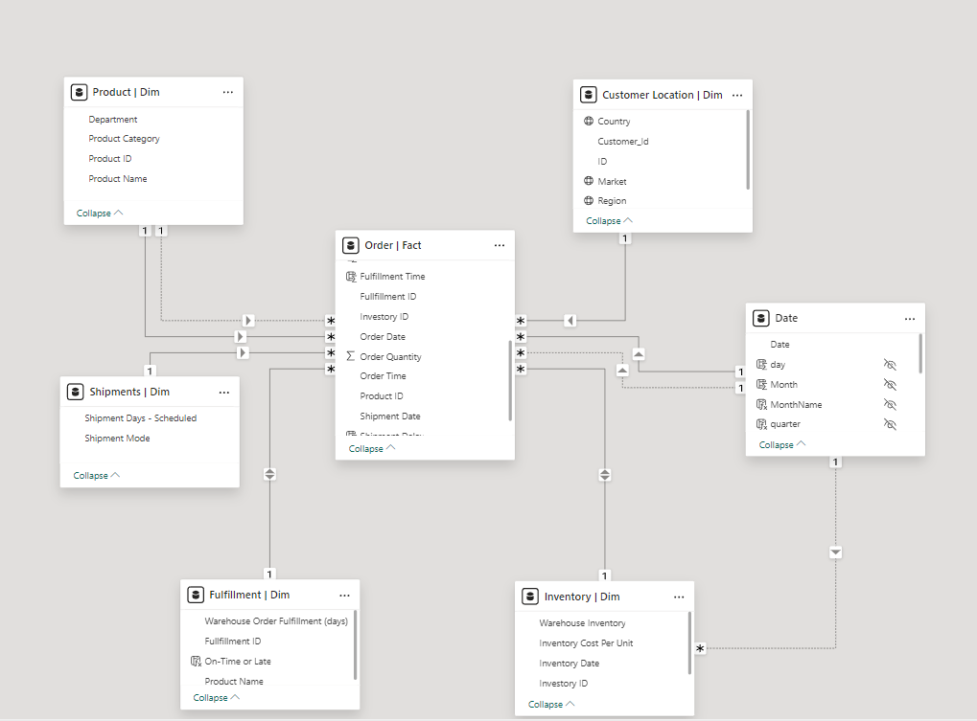
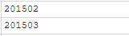
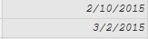
Data Processing
Data Cleaning
Data Modeling
We applied cleansing processes to the raw data to ensure data quality, accuracy and consistency.
These processes includes:
Changing all columns data type to its appropriate type.
Removed any duplicated rows.
One of the problems that we faced in the data is the date format which we fixed so we can start our Analysis.

Slide 6
Analysis Summary

Slide 7
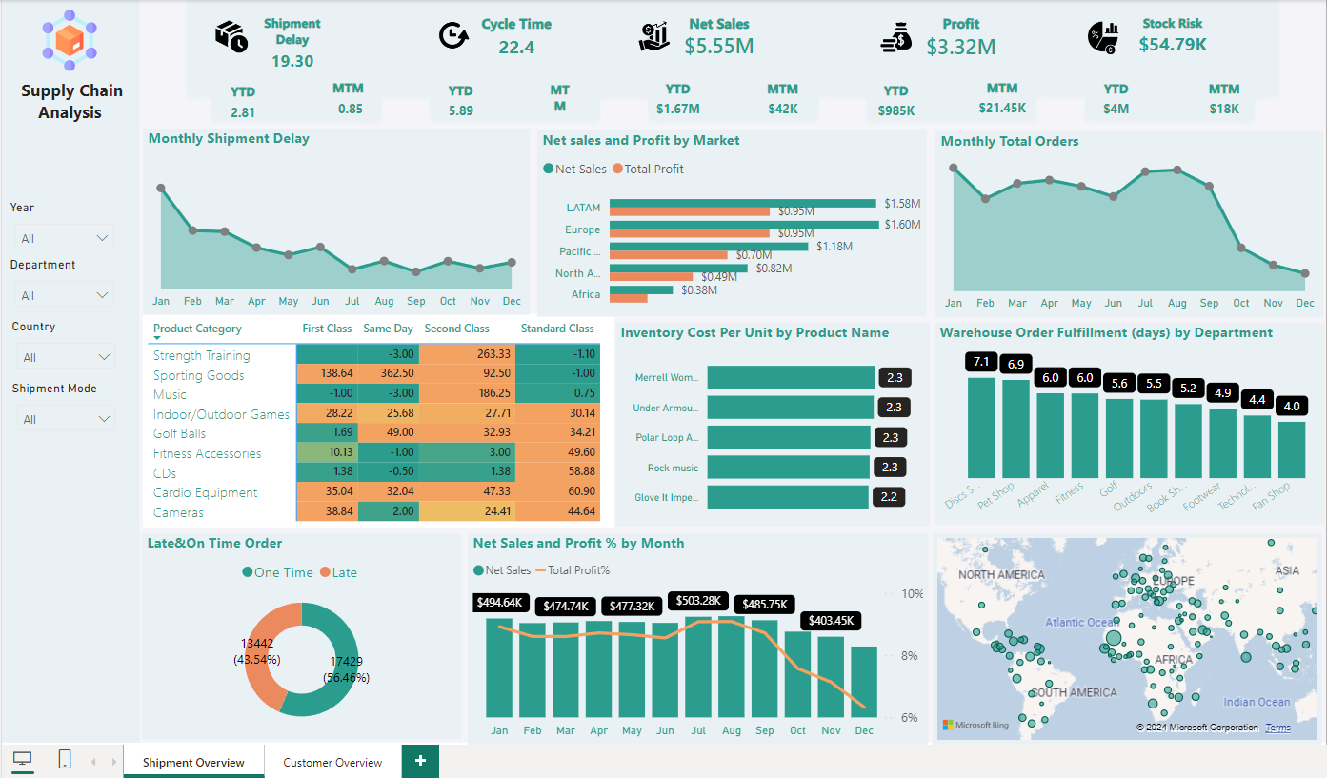
Shipment Overview

Slide 8
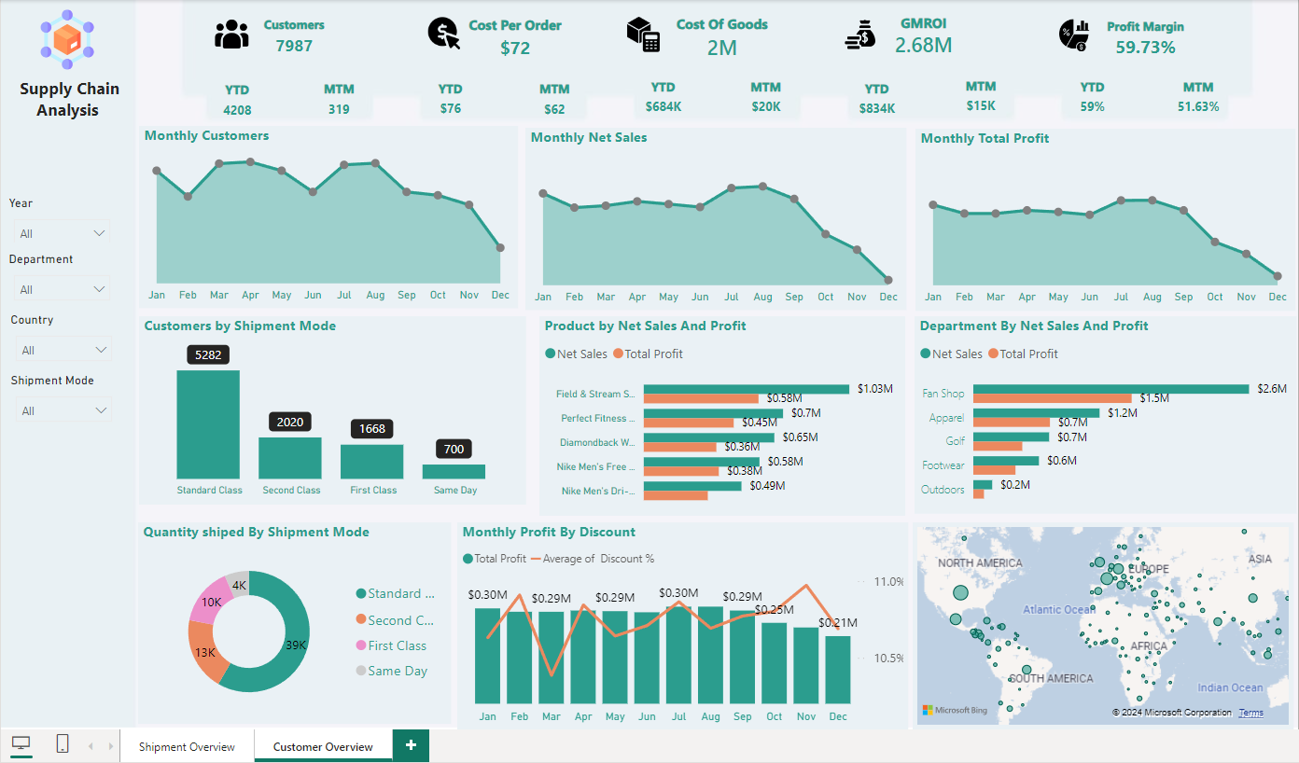
Customer Overview

Slide 9
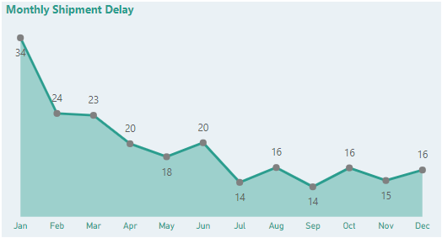
Shipment Performance
Big difference in Avg. shipment delays in Jan compared to the rest of the year with the lowest number in Dec .
This may be caused by the large number of total orders also in Jan and may be due to the annual holiday of the new year

Slide 10
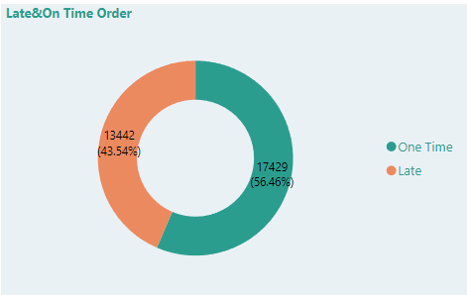
Shipment Performance
56.46% of orders were shipped on time and the rest were late shipments.
This may be caused by long (inventory turnover rate).

Slide 11
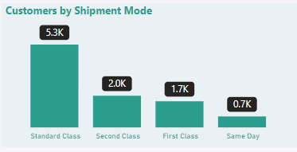
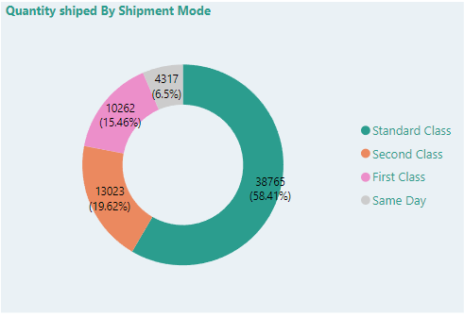
Shipment Methods
On average 5285 customer used standard shipment methods with an 58.41% of items sold shipped by standard methods
Standard shipment is the preferable shipment methods by the customers.
Our theory is that offering better shipment on large orders will make more people to spend more or at least be familiar with higher tier shipping methods.

Slide 12
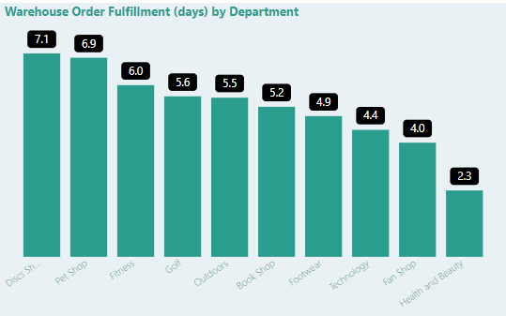
Fulfillment time
Discs shop department have the highest fulfillment time.
The Average fulfillment times is 5 days.

Slide 13
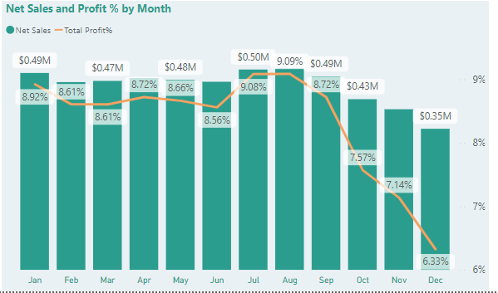
Seasonal trends
Most sales and profit generated where in Q3 of the year.
Q4 is the lowest in terms of sales.
Based on this chart, we miss holiday season sales which require immediate attention.

Slide 14
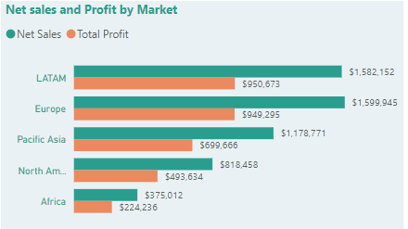
Sales & profit
LATAM is the highest profit generating market while Europe has the highest net sales.
France and Germany are both our biggest sales and profit generating countries.
Africa is low in both net sales and profit and will need more investigation.

Slide 15
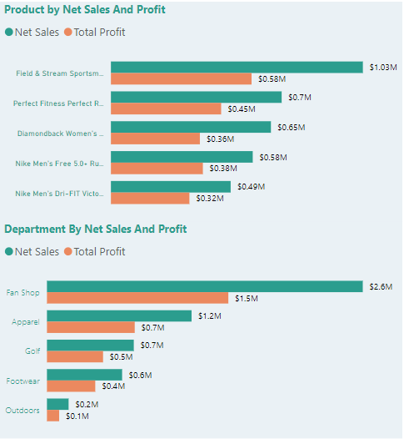
Sales & profit
Among top 5 products by sales our Average profit Is 37%.
(Field & steam sportsman 16 gun fire safe) is the highest profit generating product.
Fan shop department is the best department in profit generation.
It’s clear that the high sales won’t necessarily generate high profit.

Slide 16
Business opportunities are like buses. There’s always another one coming.
“
”
Richard Branson

Slide 17
Insights & Recommendations
“
”

Slide 18
Insights
Warehouse Delays
Shipment Delays (2017)
Profit Impact (2017)
Departments are facing delays in order fulfillment, with completion times ranging from 4 to 7 days, impacting delivery timelines.
Same Day: 18% of orders delayed (1-2 days average).
Standard Class: 25% of orders delayed (2-3 days average).
Second Class: 51% of orders delayed (3-4 days average).
First Class: 83% of orders delayed (3-4 days average).
The company lost 2,410 orders across all shipment types, resulting in $160,000 in lost sales, including $42,000 from First Class and $64,000 from Second Class.

Slide 19
Recommendations
Optimize Shipment Modes
Enhance Fulfillment Processes
Standardize shipment modes for specific types of orders to improve consistency in delivery times.
Explore partnerships with reliable carriers to ensure quicker and more consistent shipping options.
Streamline internal processes to reduce order processing times, such as implementing better inventory management systems.
Consider automating parts of the fulfillment process where possible to reduce manual errors and speed up processing.

Slide 20
Recommendations
Monitor and Adapt
Warehouse construction
Set Clear Expectations
Continuously monitor fulfillment performance metrics and gather customer feedback to adapt strategies as needed.
Regularly review and analyze shipping data to identify patterns and make data-driven adjustments.
France and Germany are both our biggest sales and profit generating countries. So, consider building a new warehouse in Europe in minimize the delays therefore increase the sales.
Improve communication with customers regarding expected delivery times and any potential delays.
Provide real-time tracking updates to enhance customer confidence in the delivery process.

Slide 21

Reference & Contact Info
Team Members:
Asmaa Ahmed
WhatsApp: 01061658064
Amir Mohammed
WhatsApp: 01064035458
Nariman Abdo Khalil
WhatsApp: 01093344115
Mahmoud Abdullah
WhatsApp: 01142519662

Slide 22

Thank you

